Slide 1
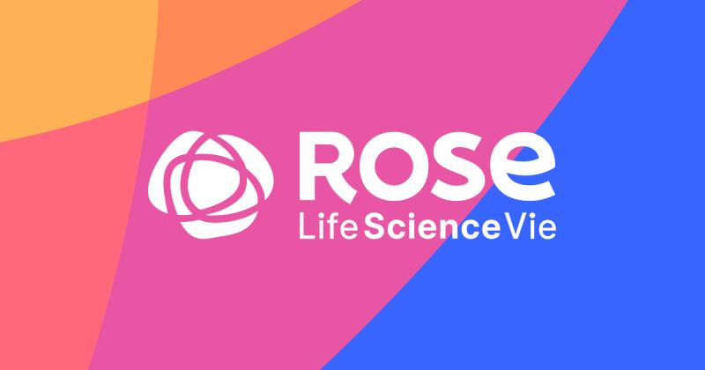

ROSE LifeScience Inc.
Case Study
Kapil Sharma

Slide 2
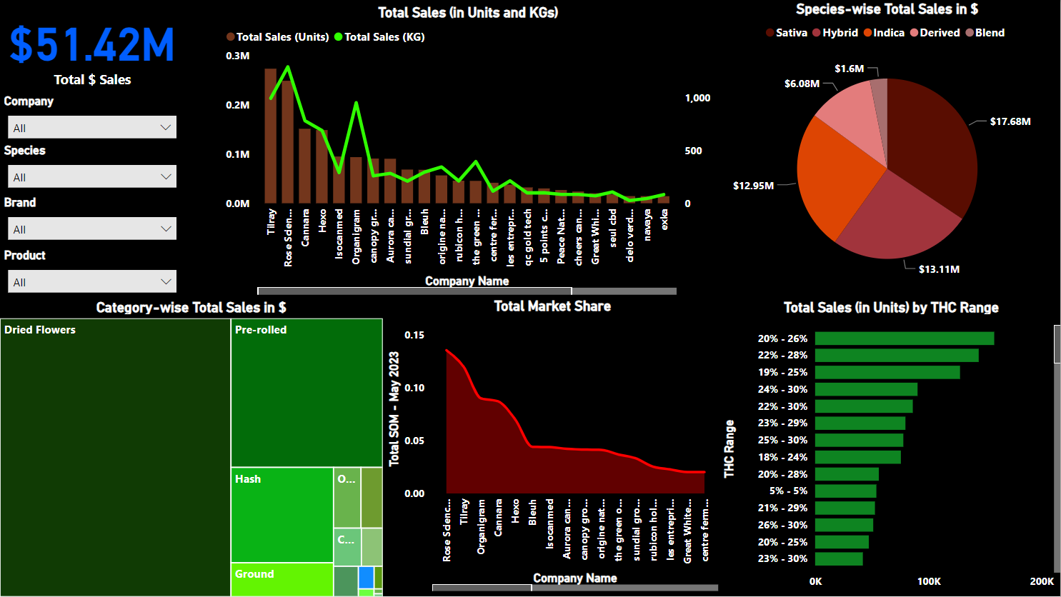
Key Performance Indicators (KPIs) Dashboard
*The dashboard and all visualizations in it are made using May 2023 SKUs Dataset provided by the company.

Slide 3
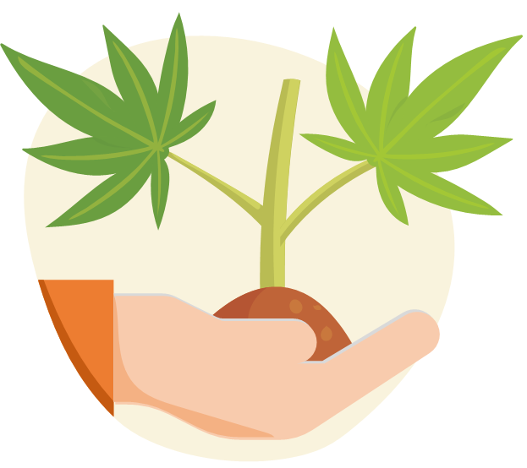
Key Performance Indicators (KPIs) for Cannabis Market
% Stores in Stock
Total $ Sales
Sales (Units)
SOM by Product
Sales (KG)

Slide 4
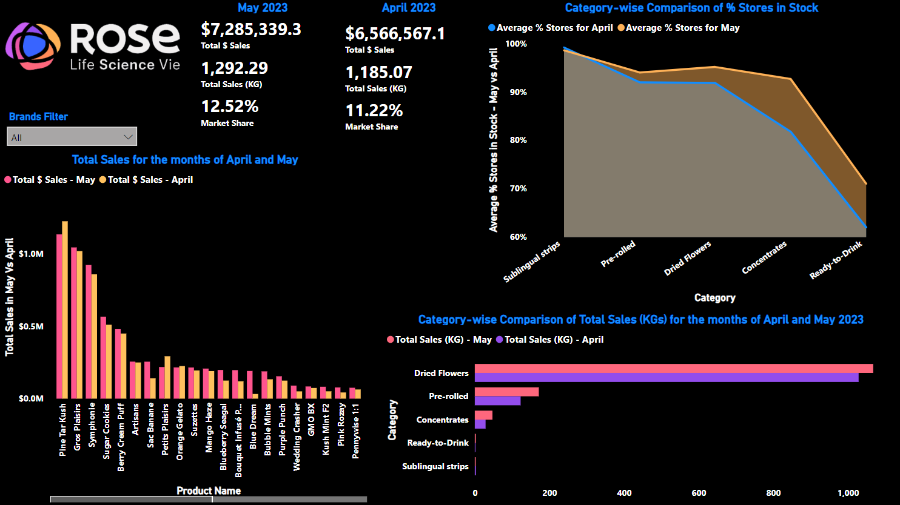
Performance Drivers Dashboard

Slide 5

Performance Drivers for Rose LifeScience Inc.
Market Demand Analysis:
Total Sales Increase: There is an increase in total sales from $6,566,567.1 in April to $7,285,339.3 in May, which is a growth of 10.95%.
Market Share Growth: The market share also increased from 11.22% in April to 12.52% in May, which is a growth of 11.58%.
Both these factors indicate that there is an increasing demand for ROSE’s products.
Product Availability (Product Supply):
Category-wise Stock Levels: The average percentage of stores in stock showed a slight decrease for “Dried Flowers” and “Pre-rolled”. This could indicate a higher demand or a lower supply for these categories.
Category-wise Sales Comparison: Total sales (KG) increased for all categories with “Dried Flowers” having the highest sales volume. This could indicate a preference for this category among the customers.
Based on the above analysis, Dried Flowers and Pre-rolled category products should be supplied more to meet the increasing demand in the market.

Slide 6
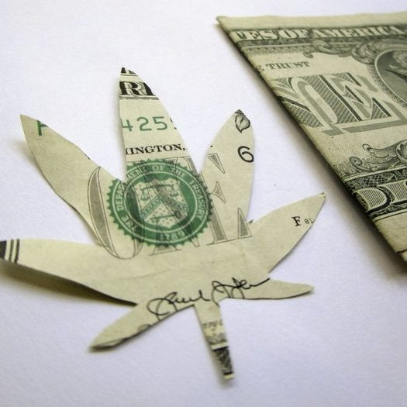
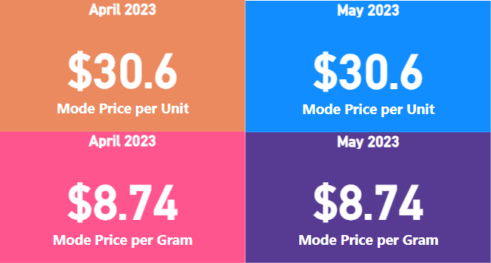
Cannabis Purchasing Cost in Quebec
The Price at which majority of Quebec consumers are purchasing their cannabis is -

Slide 7

Best Cannabis KPI
If I had access to all the Quebec Cannabis data in the world, I would build the below important Marketing KPIs:
Customer Acquisition Cost (CAC)
Retention Costs
Customer Life Time Value (LTV).
These KPIs will enable the company to analyze and closely monitor their marketing spend and will help them to decide how much to spend on attracting and retaining customers.

Slide 8

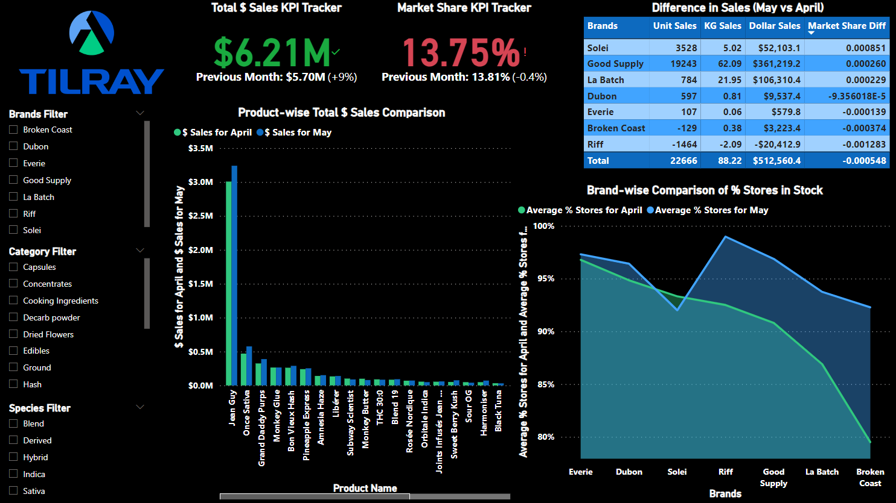
Tilray’s May Performance Review Dashboard

Slide 9
Tilray’s May Performance Review
Key Insights
Increase in total sales by 9%, surpassing the goal of $5.70M by 9%.
Decrease in Market share by 0.45%.
Brands with positive growth in market share: Solei, Good Supply, La Batch, Dubon, and Broken Coast.
Brands with negative growth in market share: Riff, Dubon, Everie, and Broken Coast.
Best performing products: Jean Guy, Once Sativa and Grand Daddy Purp.
New product launch in Solei brand.
Increase in supply of Riff, Good Supply, La Batch, and Broken Coast branded products, indicating increase in sales for those brands.
Recommendations
Analyze competitors’ strategies during May. Investigate the reasons behind Riff’s poor performance and consider revising its marketing or production strategies.
Enhance supply chain efficiency to ensure popular products are always available.

Slide 10
What caught your attention
While doing this exercise, building dashboards, and generating insights about the cannabis industry, I found some really interesting facts which caught my attention:
While cannabis is mostly related with generating ‘High’ or with ‘stimulating’ effects, cannabis has a lot of medicinal benefits as well. Depending on the strain, the dosage and the individual, both CBD (Cannabidiol) and THC (Tetrahydrocannabinol) compounds present in cannabis can help an individual in multiple ways.
Cannabis can be categorized into a lot of different segments and come in a lot of different formats. Some of the categories which are new to my knowledge are sublingual strips and ready-to-drink formats.

Slide 11




